Slide 1
Capability Update Initiative Briefing
Public Health Emergency Preparedness and Response Capabilities: National Standards for State, Local, Tribal, and Territorial Public Health
DeAndrea Martinez, MPH
Public Health Analyst
Program Planning and Development Unit
Division of State and Local Readiness (DSLR)
National Indian Health Board
March 2019

Slide 2
Session Objectives
The purpose of this session is to provide the National Indian Health Board with an overview of the capability update initiative.
Specific objectives include:
Provide a description of the capability standards
Describe the purpose and approach for the capability update initiative
Explain the capability definitions

Slide 3
Agenda
Introduction: Revisiting the “Premise” of the Capabilities
Capability Update Initiative Overview
Capability Definitions
Questions and Answers

Slide 4
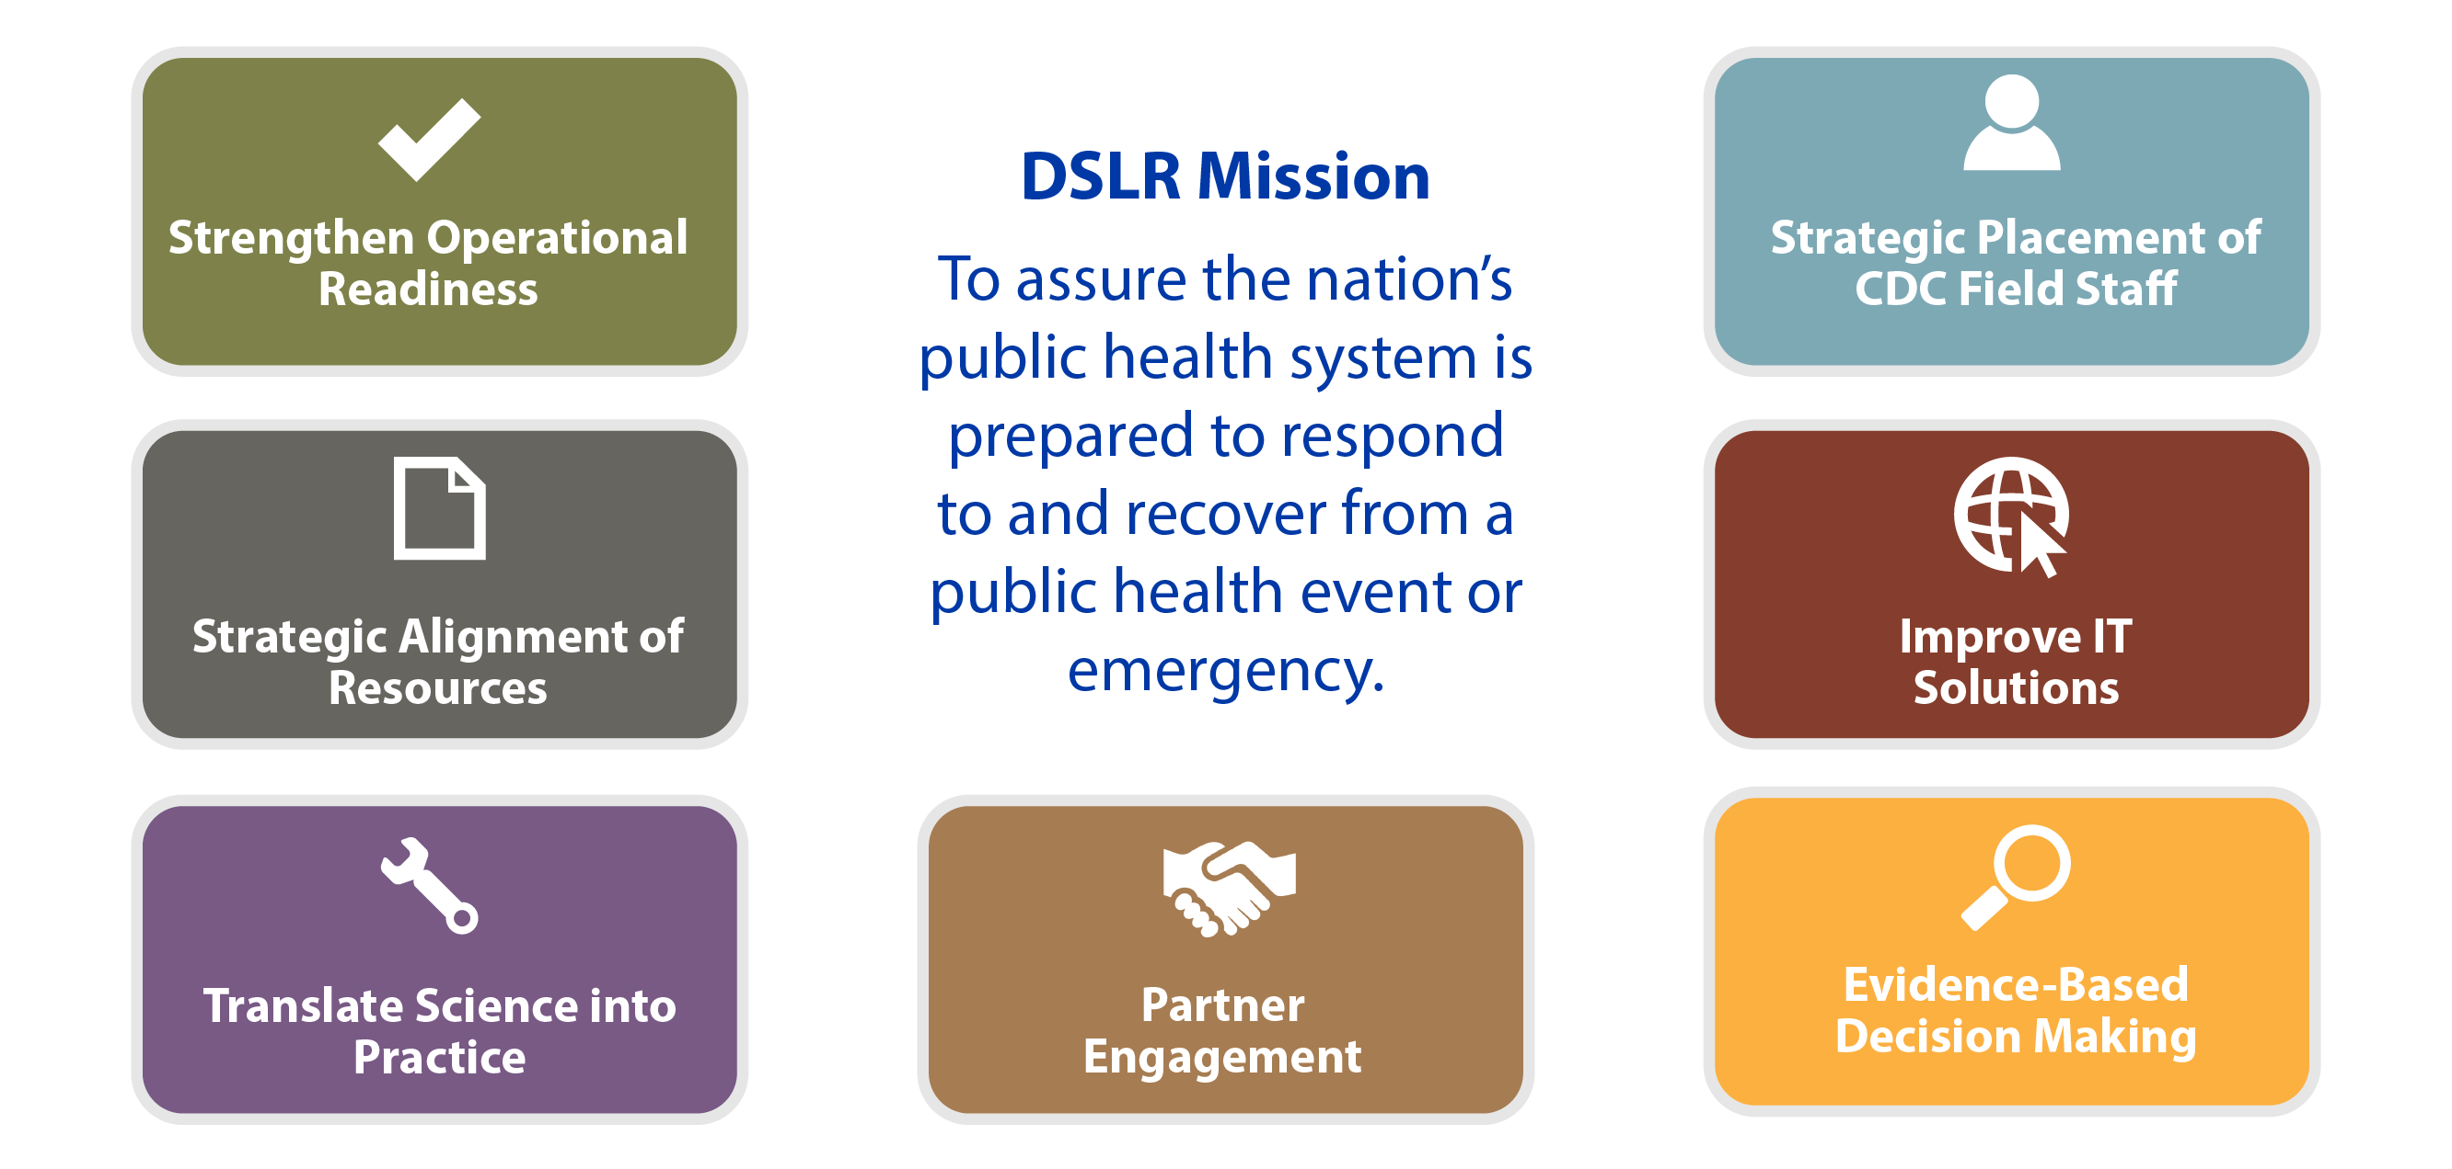
Division of State and Local Readiness (DSLR)
Mission and Strategic Priorities
Notes:
The Division of State and Local Readiness (DSLR) within the Centers for Disease Control and Prevention, achieves it mission to assure the nation’s public health system is prepared to respond and recover from a public health event or emergency through seven strategic priorities.

Slide 5
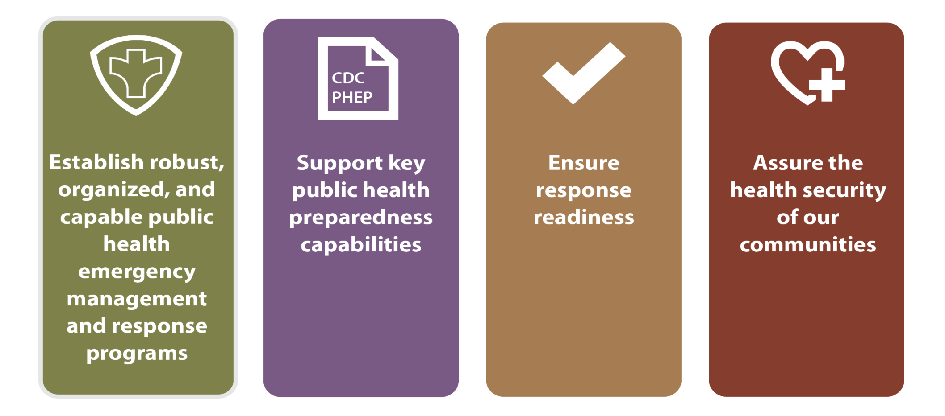
Public Health Emergency Preparedness (PHEP) Program Objectives
Notes:
The Public Health Emergency Preparedness (PHEP) Program Objectives are to
Establish robust, organized, and capable public health emergency management and response programs
Support key public health preparedness capabilities
Ensure response readiness
Assure the health security of our communities
CDC provide the common defense of the country against health threats.
Science. Surveillance. Service

Slide 6
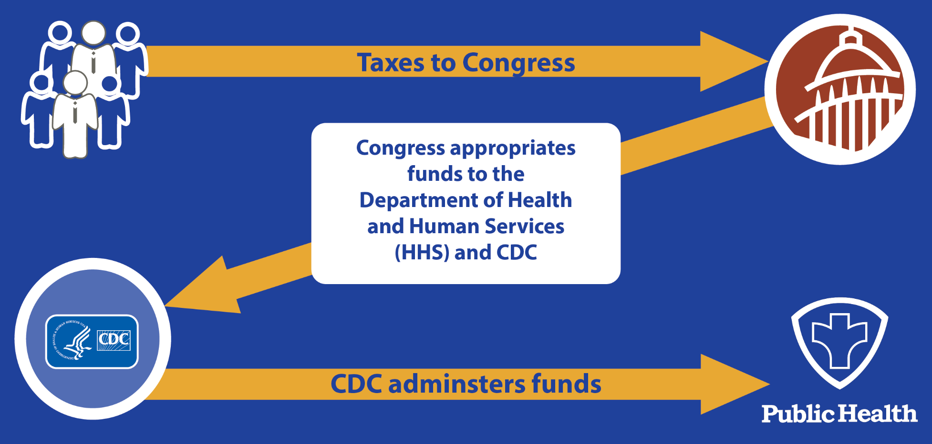
Funding State and Local Preparedness Programs
CDC administers awards
Notes:
Once CDC receives these funds from Congress, CDC administers it to state, local, tribal, and territorial public health departments through the PHEP Cooperative Agreement

Slide 7
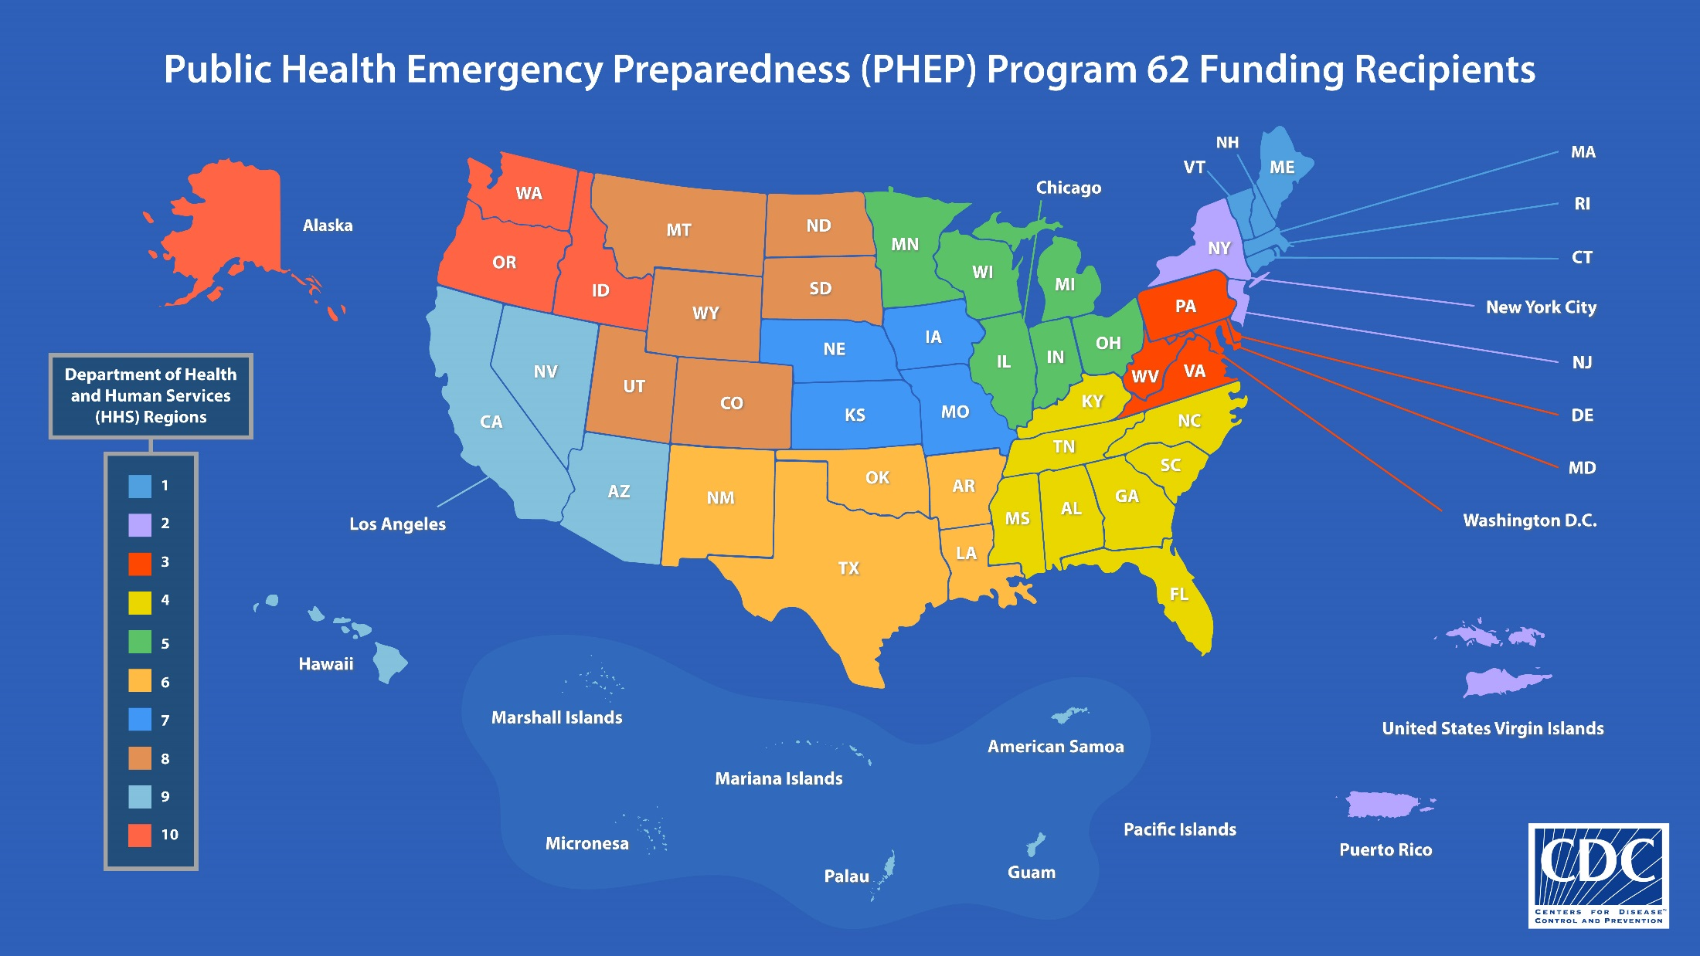
Notes:
The PHEP cooperative agreement funds the 50 states, 8 territories and freely associated states, and 4 of the largest metropolitan health departments (New York City, Chicago, Los Angeles, and Washington, D.C.)

Slide 8
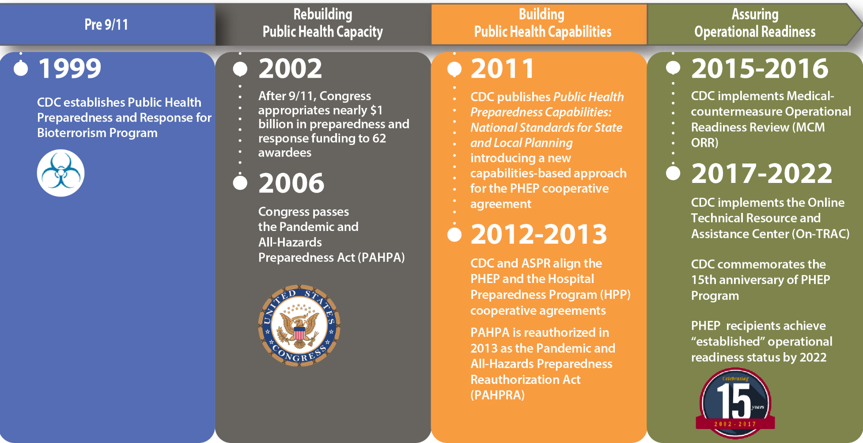
Evolution of the PHEP Program
Notes:
The PHEP Program was established in 1999 as a $40 million competitive grant with a bioterrorism focus and 53 awardees.

Slide 9
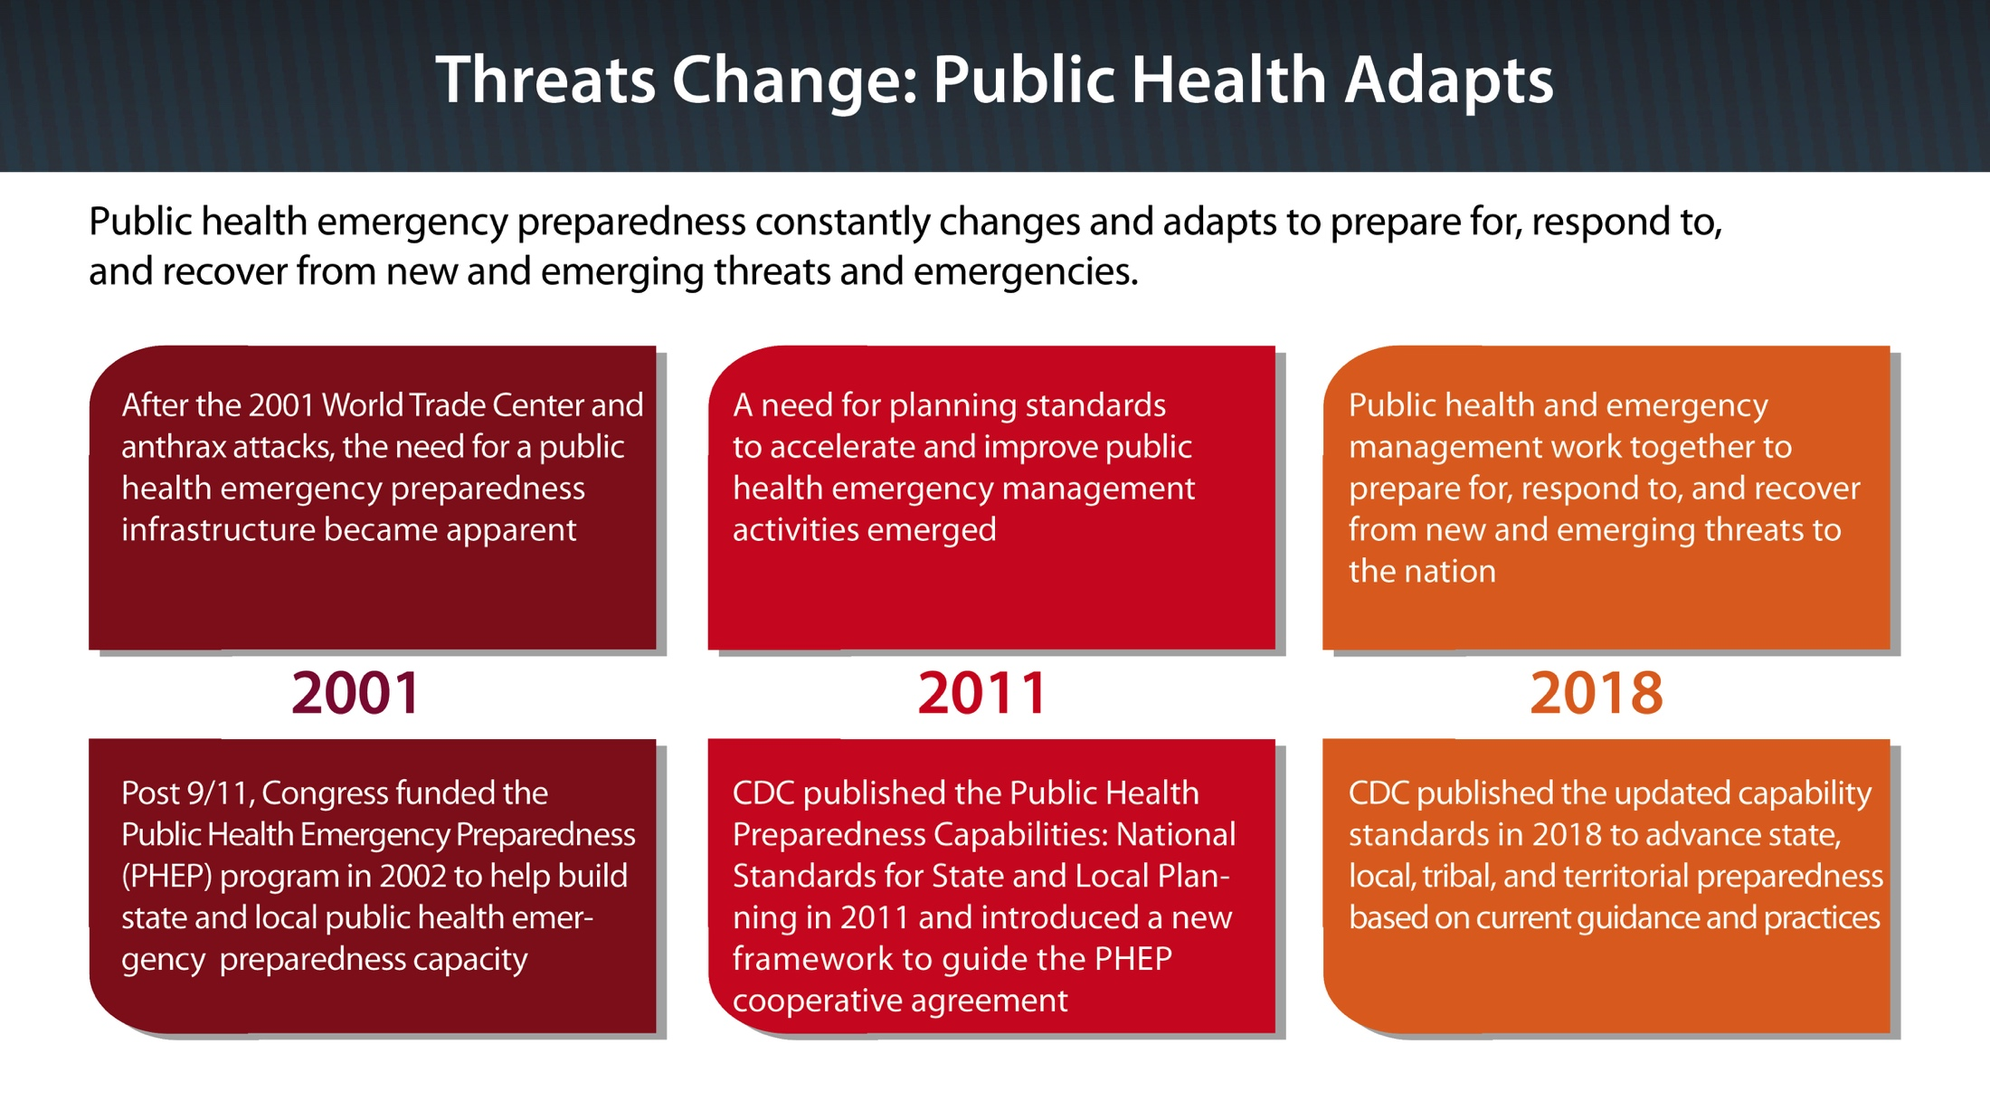

Slide 10
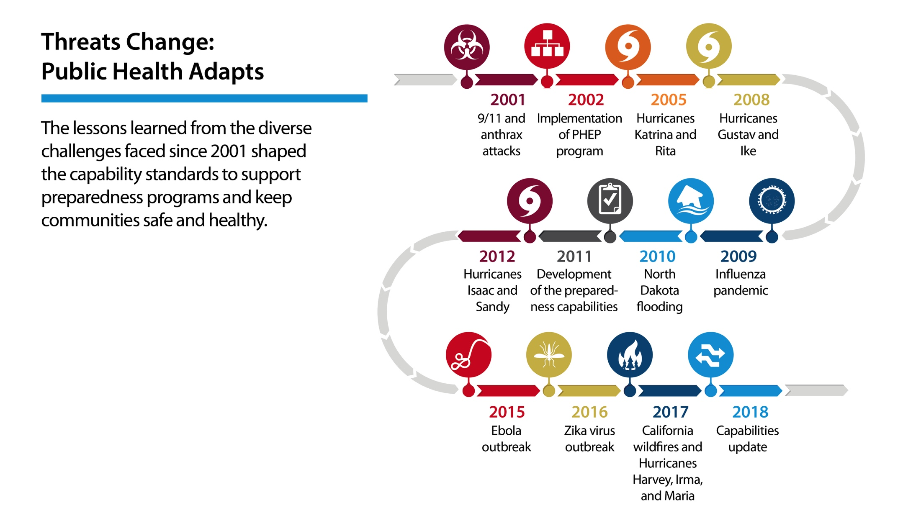

Slide 11
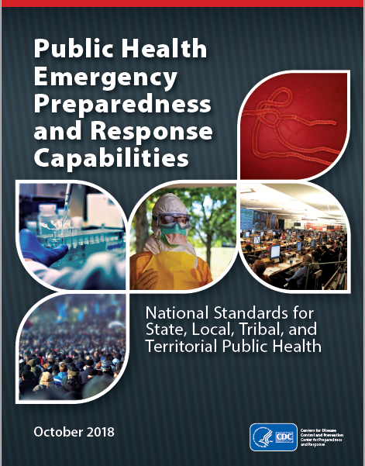
Public Health Emergency Preparedness and Response Capabilities
Community Preparedness
Community Recovery
Emergency Operations Coordination
Emergency Public Information and Warning
Fatality Management
Information Sharing
Mass Care
Medical Countermeasure Dispensing and Administration
Medical Materiel Management and Distribution
Medical Surge
Nonpharmaceutical Interventions
Public Health Laboratory Testing
Public Health Surveillance and Epidemiological Investigation
Responder Safety and Health
Volunteer Management

Slide 12
Capabilities by Domain
Domain | Capability
1. Community Resilience | Capability 1: Community Preparedness Capability 2: Community Recovery
2. Incident Management | Capability 3: Emergency Operations Coordination
3. Information Management | Capability 4: Emergency Public Information and Warning Capability 6: Information Sharing
4. Countermeasures and Mitigation | Capability 8: Medical Countermeasure Dispensing and Administration Capability 9: Medical Materiel Management and Distribution Capability 11: Nonpharmaceutical Interventions Capability 14: Responder Safety and Health
5. Surge Management | Capability 5: Fatality Management Capability 7: Mass Care Capability 10: Medical Surge Capability 15: Volunteer Management
6. Biosurveillance | Capability 12: Public Health Laboratory Testing Capability 13: Public Health Surveillance and Epidemiological Investigation

Slide 13
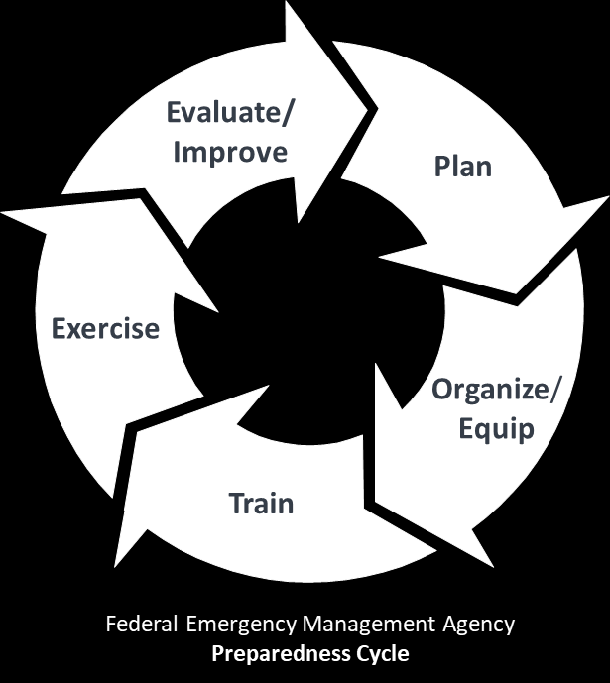
Designed for state, local, tribal, and territorial preparedness program development…
…the capabilities support the full preparedness cycle.

Slide 14
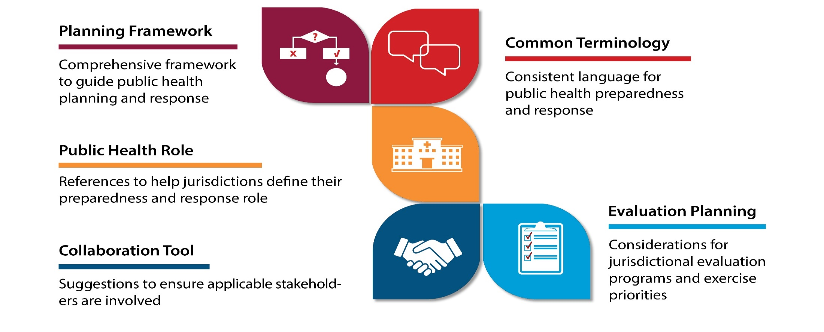
The Capabilities Support the Following Functions…

Slide 15
Key Messages about the Capabilities
What the capabilities are | What they are NOT
Standards for public health emergency management programs | NOT specific Notice of Funding Opportunity guidance
Roadmap, direction-setting framework | NOT a destination or end point
Recommendation of “what to do” | NOT “how to do it” in every instance
A “menu” of considerations for preparedness program development | NOT prescriptive mandates or requirements
Decision support for how to build and sustain the capabilities according to jurisdictional priorities | NOT performance measures

Slide 16
Capability Update Initiative Overview

Slide 17
Capability Update Purpose
Reasons for Update
Lessons learned from recent incidents and events
Evolution of guidance, standards, and practices
Feedback indicating a need to update
  PHEP program review
  2017 National Association of County and City Health Officials (NACCHO) Preparedness Summit (feedback from the practice community)
  Assessment of Public Health Preparedness Capabilities report
  DSLR staff survey (internal staff feedback)

Slide 18
Capability Update Purpose (Cont.)
Update Objectives – State, Local, Tribal, and Territorial Utility
Strengthen cross-cutting and intersecting program areas
Simplify and streamline language without loss of meaning
Emphasize planning and operational readiness
Update content in resource elements, tasks and definitions, as needed
Update preface to set the context of capabilities and their use

Slide 19
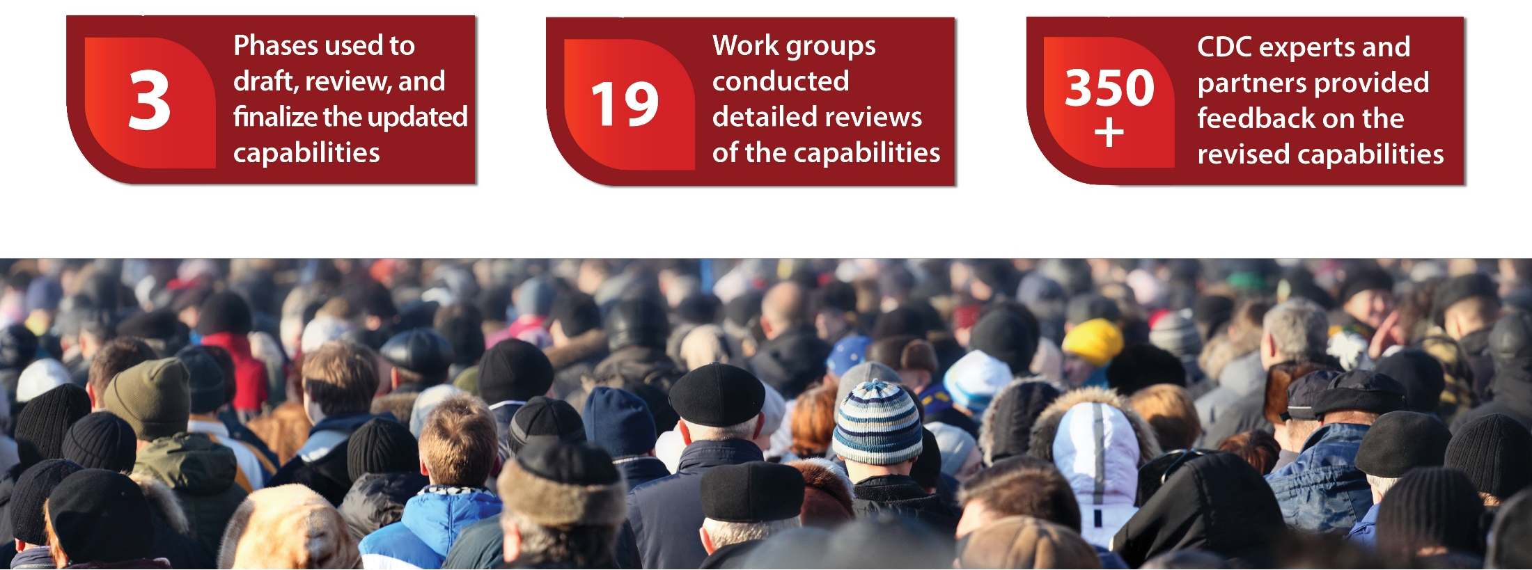
2018 Capability Update Initiative
How were the updates made?

Slide 20
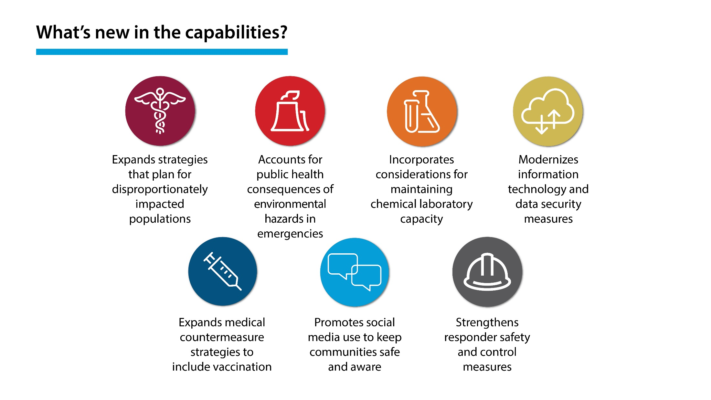
What’s New in the Capabilities

Slide 21
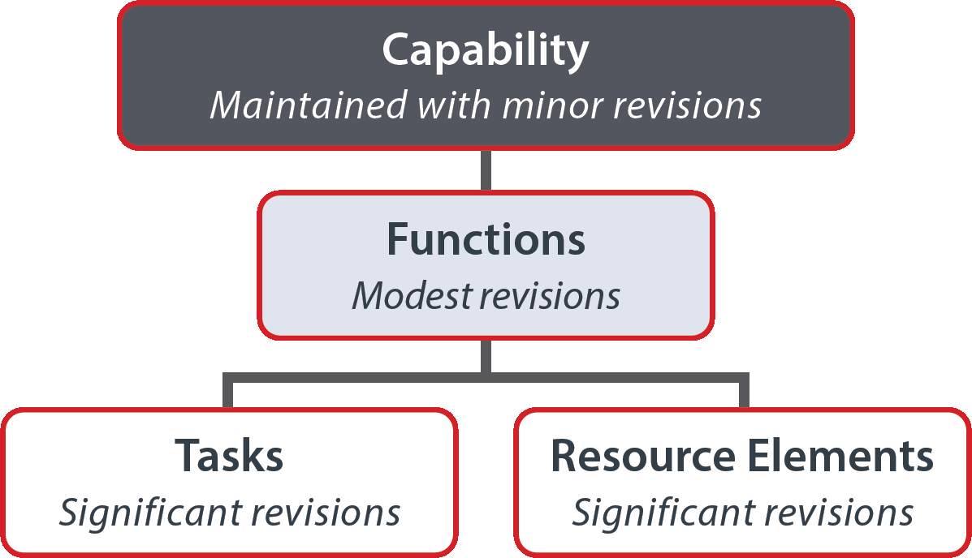
Capability Update Overview
Scope of Content Changes
Edits are mostly focused on tasks and resource elements, but also include changes to functions and capability definitions
The 15 capabilities were retained, but the title of Capability 8 was changed to Medical Countermeasure Dispensing and Administration to account for vaccine and antitoxin administration

Slide 22
Capability Update Overview (Cont.)
Document-Level Changes
Updated the introduction to the capabilities document
Removed performance measures (measurement will be done with the Operational Readiness Review [ORR])
Reordered Resource Elements to align with task sequencing
Used active voice to transition focus of document from planning to execution and demonstration
  Renamed “Planning” Resource Elements to “Preparedness” Resource Elements
  Communicate “Procedures in place…”, rather than “Written Plans should include…”
Updated considerations for tribal populations, at-risk populations, environmental health, and pandemic influenza throughout each capability

Slide 23
What has Not Changed
15 original capabilities and their original structure were retained
Tier 1 capabilities maintained their Tier 1 categorization
Capabilities remained aligned to the original 6 domains:
  Community Resilience
  Incident Management
  Information Management
  Countermeasures and Mitigation
  Surge Management
  Biosurveillance
Capabilities are informed by current preparedness guidance, science, practice, and subject matter expert input
Capabilities will support “everyday use” – sustainability

Slide 24
Alignment with Other Standards
The updated capabilities continue to align well with related emergency preparedness and response program standards
FEMA Core Capabilities
The Public Health Emergency Preparedness and Response Capabilities operationalize the public health components of FEMA’s 32 core capabilities
Interdisciplinary coordination between public health, health care, and emergency management is critical to effective emergency preparedness and response
Public Health Accreditation Board (PHAB)
The capability standards support PHAB accreditation efforts as the two have been developed with input and consideration for each other
Guidance on how PHAB and capability standards align has been developed to support state, local, and territorial program planning and accreditation efforts
Notes:
The Public Health Accreditation Board is a 501(c)3 nonprofit organization dedicated to improving and protecting the health of the public by advancing and ultimately transforming the quality and performance of state, local, tribal, and territorial public health departments.
National Voluntary Accreditation for Public Health Departments
As of Nov. 20, 2018, a total of 244 health departments (33 state, 2 Tribal and 209 local) as well as 1 statewide integrated local public health department system, have achieved five-year accreditation through the Public Health Accreditation Board, bringing the benefits of PHAB accreditation to 73 percent of the U.S. population. Below is the complete list, with links to their websites. You may also download an Excel Spreadsheet containing important information about each PHAB-accredited health department, including the date of their accreditation and the version of the PHAB Standards and Measures under which they were accredited. Read the press release.

Slide 25


Alignment with Other Standards (Cont.)
The updated capabilities continue to align well with related emergency preparedness and response program standards
NACCHO Project Public Health Ready (PPHR)
There is a strong connection between the capability standards and PPHR criteria
Both programs are focused on establishing and promoting national standards for local public health preparedness and all-hazards preparedness
Notes:
Project Public Health Ready
Project Public Health Ready (PPHR) is a criteria-based training and recognition program that assesses local health department capacity and capability to plan for, respond to, and recover from public health emergencies. PPHR aims to protect the public's health and strengthen the public health infrastructure by equipping local health departments with sustainable tools to plan, train, and exercise using a continuous quality improvement model.
Since 2004, more than 500 LHDs have been recognized as meeting all the PPHR requirements individually or working collaboratively as a region, all of which are identified in the map below.
Interested agencies are encouraged to browse the featured resources listed below and to contact NACCHO's PPHR team via email at PPHR@naccho.org for more information about initiating the application process.

Slide 26
Suggested Resources to Support the Capability Standards
Added nationally recognized guidance, trainings, and tools to suggested resources
Updated and expanded the list of suggested resources and used them to inform capabilities content
Migrated suggested resources to CDC’s Online Technical Resource and Assistance Center (On-TRAC) (https://ontrac.cdc.gov) and CDC’s State and Local Readiness website (https://www.cdc.gov/cpr/readiness)

Slide 27
Public Health Preparedness Resources
CDC offers resources to assist health departments with their strategic planning to strengthen their public health preparedness capabilities:
  On-TRAC https://www.cdc.gov/cpr/readiness/on-trac.htm
  Public Health Emergency Preparedness and Response Capabilities https://www.cdc.gov/cpr/readiness/capabilities.htm
  Infographics https://www.cdc.gov/cpr/readiness/graphics.htm
  Additional Preparedness Resources www.cdc.gov/cpr/readiness/resources.htm
Notes:
Main source of resources is On-TRAC

Slide 28
Example of Tribal Updates
Community Preparedness (Capability 1) : Highlights the importance of partnerships with tribal organizations in public health preparedness and response activities
Medical Countermeasure Dispensing and Administration (Capability 8): Alternate approaches for reaching tribal populations, including cross-jurisdictional agreements
Nonpharmaceutical Interventions (Capability 11): Information sharing between CDC and state, local, tribal, territorial public health authorities, including protection of sensitive information, such as protected health information

Slide 29
Questions and Answers

Slide 30
Thank you!

Slide 31
Appendix: Capability Definitions

Slide 32
Domain 1: Community Resilience (slide 1 of 2)
Definition
Capability 1: Community Preparedness
Community preparedness is the ability of communities to prepare for, withstand, and recover from public health incidents in both the short and long term.

Slide 33
Domain 1: Community Resilience (slide 2 of 2)
Definition
Capability 2: Community Recovery
Community recovery is the ability of communities to identify critical assets, facilities, and other services within public health, emergency management, health care, human services, mental/behavioral health, and environmental health sectors that can guide and prioritize recovery operations.

Slide 34
Domain 2: Incident Management
Definition
Capability 3: Emergency Operations Coordination
Emergency operations coordination is the ability to coordinate with emergency management and to direct and support an incident or event with public health or health care implications by establishing a standardized, scalable system of oversight, organization, and supervision that is consistent with jurisdictional standards and practices and the National Incident Management System (NIMS).

Slide 35
Domain 3: Information Management (slide 1 of 2)
Definition
Capability 4: Emergency Public Information and Warning
Emergency public information and warning is the ability to develop, coordinate, and disseminate information, alerts, warnings, and notifications to the public and incident management personnel.

Slide 36
Domain 3: Information Management (slide 2 of 2)
Definition
Capability 6: Information Sharing
Information sharing is the ability to conduct multijurisdictional and multidisciplinary exchange of health-related information and situational awareness data among federal, state, local, tribal, and territorial levels of government and the private sector.
This capability includes the routine sharing of information as well as issuing of public health alerts to all levels of government and the private sector in preparation for and in response to events or incidents of public health significance.

Slide 37
Domain 4: Countermeasures and Mitigation (slide 1 of 4)
Definition
Capability 8: Medical Countermeasure Dispensing and Administration
Medical countermeasure dispensing and administration is the ability to provide medical countermeasures to targeted population(s) to prevent, mitigate, or treat the adverse health effects of a public health incident, according to public health guidelines.
This capability focuses on dispensing and administering medical countermeasures, such as vaccines, antiviral drugs, antibiotics, and antitoxins.

Slide 38
Domain 4: Countermeasures and Mitigation (slide 2 of 4)
Definition
Capability 9: Medical Materiel Management and Distribution
Medical materiel management and distribution is the ability to acquire, manage, transport, and track medical materiel during a public health incident or event and the ability to recover and account for unused medical materiel, such as pharmaceuticals, vaccines, gloves, masks, ventilators, or medical equipment after an incident.

Slide 39
Domain 4: Countermeasures and Mitigation (slide 3 of 4)
Definition
Capability 11: Nonpharmaceutical Interventions
DefiNonpharmaceutical interventions are actions that people and communities can take to help slow the spread of illness or reduce the adverse impact of public health emergencies.
This capability focuses on communities, community partners, and stakeholders recommending and implementing nonpharmaceutical interventions in response to the needs of an incident, event, or threat.

Slide 40
Domain 4: Countermeasures and Mitigation (slide 4 of 4)
Definition
Capability 14: Responder Safety and Health
Responder safety and health is the ability to protect public health and other emergency responders during pre-deployment, deployment, and post-deployment.

Slide 41
Domain 5: Surge Management (slide 1 of 4)
Definition
Capability 5: Fatality Management
Fatality management is the ability to coordinate with partner organizations and agencies to provide fatality management services.
The public health agency role in fatality management activities may include supporting
  Recovery and preservation of remains
  Identification of the deceased
  Determination of cause and manner of death
  Release of remains to an authorized individual
  Provision of mental/behavioral health assistance for the grieving

Slide 42
Domain 5: Surge Management (slide 2 of 4)
Definition
Capability 7: Mass Care
Mass care is the ability of public health agencies to coordinate with and support partner agencies to address, within a congregate location (excluding shelter-in-place locations), the public health, health care, mental/behavioral health, and human services needs of those impacted by an incident.
This capability includes coordinating ongoing surveillance and public health assessments to ensure that health needs continue to be met as the incident evolves.

Slide 43
Domain 5: Surge Management (slide 3 of 4)
Definition
Capability 10: Medical Surge
Medical surge is the ability to provide adequate medical evaluation and care during events that exceed the limits of the normal medical infrastructure of an affected community.
It encompasses the ability of the health care system to endure a hazard impact, maintain or rapidly recover operations that were compromised, and support the delivery of medical care and associated public health services, including disease surveillance, epidemiological inquiry, laboratory diagnostic services, and environmental health assessments.

Slide 44
Domain 5: Surge Management (slide 4 of 4)
Definition
Capability 15: Volunteer Management
Volunteer management is the ability to coordinate with emergency management and partner agencies to identify, recruit, register, verify, train, and engage volunteers to support the jurisdictional public health agency’s preparedness, response, and recovery activities during pre-deployment, deployment, and post-deployment.

Slide 45
Domain 6: Biosurveillance (slide 1 of 2)
Definition
Capability 12: Public Health Laboratory Testing
Public health laboratory testing is the ability to implement and perform methods to detect, characterize, and confirm public health threats.
It also includes the ability to report timely data, provide investigative support, and use partnerships to address actual or potential exposure to threat agents in multiple matrices, including clinical specimens and food, water, and other environmental samples.

Slide 46
Domain 6: Biosurveillance (slide 2 of 2)
Definition
Capability 13: Public Health Surveillance and Epidemiological Investigation
Public health surveillance and epidemiological investigation is the ability to create, maintain, support, and strengthen routine surveillance and detection systems and epidemiological investigation processes.
It also includes the ability to expand these systems and processes in response to incidents of public health significance.

